Slide 1
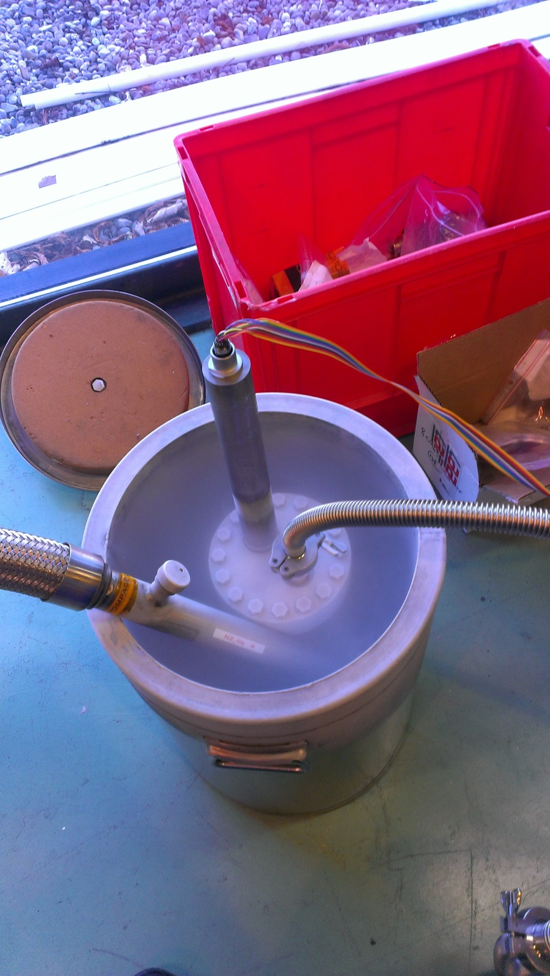

Optical Wire Position Monitor
Wojciech Żak
wojciech.zak@cern.ch

Slide 2
Outline
Application of the OPWM in the SPL Mock-up
Idea of the Optical Wire Position Monitor
Conception tests and calibration at warm
Tests at liquid nitrogen
Behavior of components with temperature
Conclusions

Slide 3
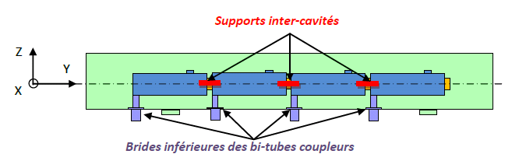
SPL SCM Cavity position monitoring specs:
Static position or slow movements: absolute movements (x,y,z) of each of 4 cavities during steady state operation and cool-down/warm-ups (300-2 K)
Vertical range 0-2 mm
Precision < 0.05 mm
Resolution < 0.01 mm
Possibly vibration measures (0-1 kHz)
Stretched wire
Opto-coupler sensors
Last cavity support
Courtesy of V. Parma

Slide 4
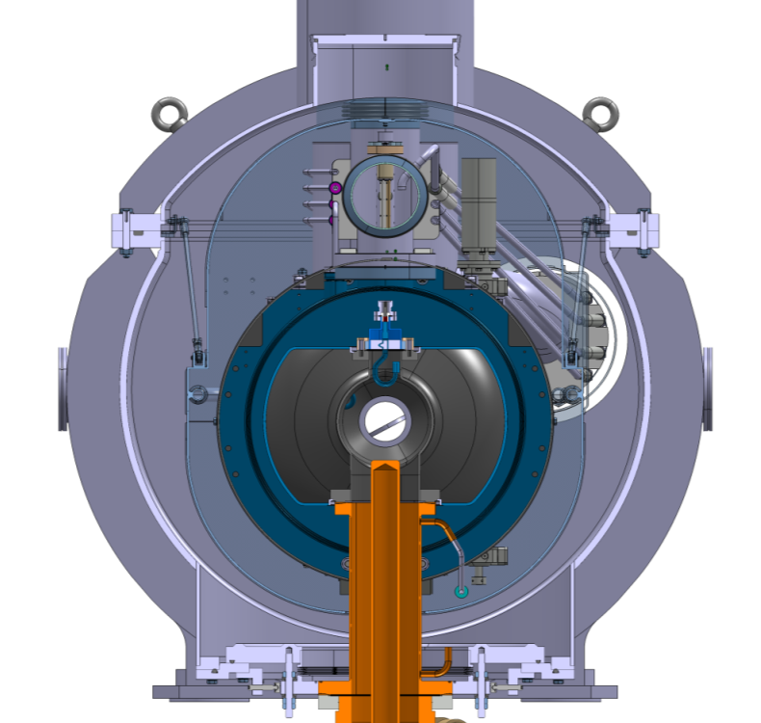
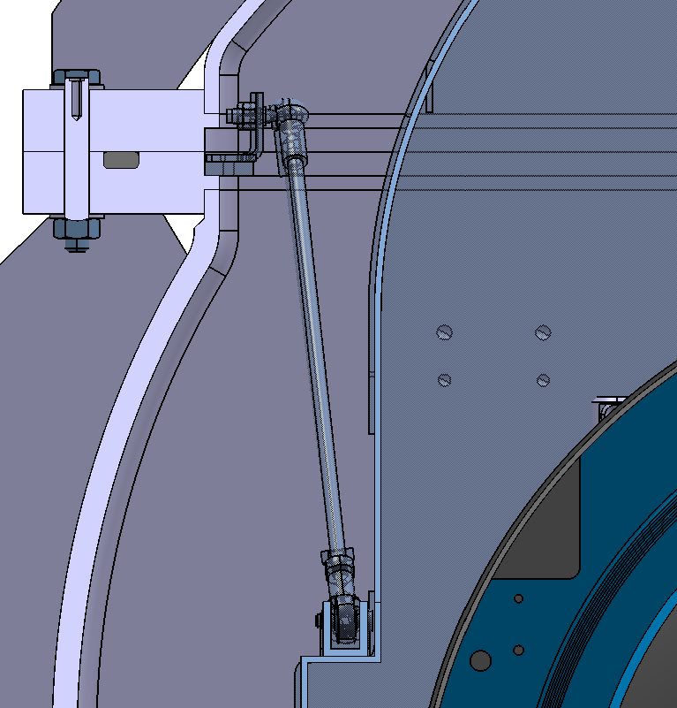
OWPM position on the SPL SCM
Thermal shield
interface
Stretched wire measuring system interface
Courtesy of CNRS

Slide 5
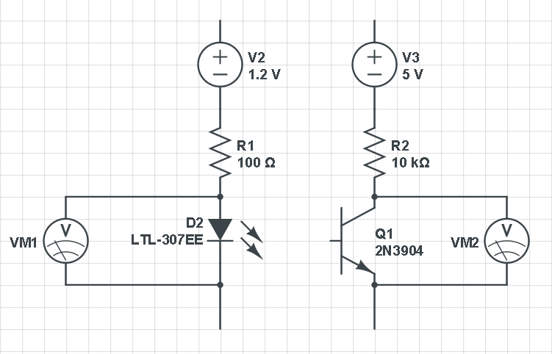
How does it work?
wire

Slide 6
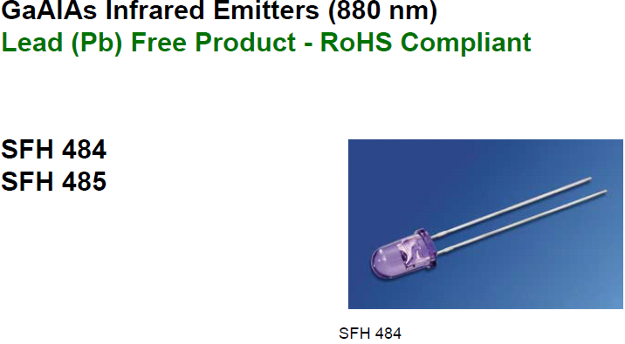

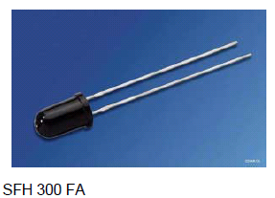
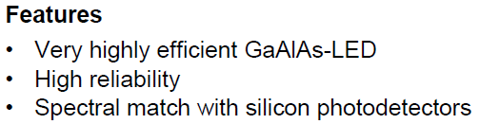
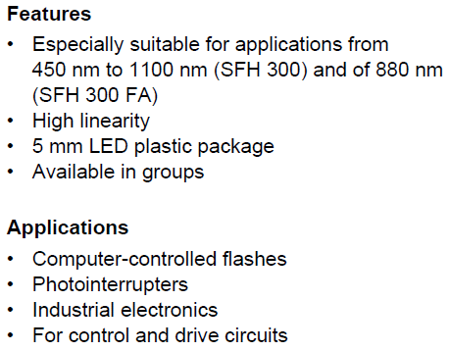

LED and photo-transistor

Slide 7
Requirements for the sensor
Simple as possible
Work with a known characteristics “at cold” and “at warm”
Adjustable position to cope with a sag from stretched wire
Φ of a wire should have Φ equals to 1/3 of the Φ of a LED
Gap between LED and transistor should be bigger than the Φ of the wire
Minimalize heat load to the cryostat from the light source and receiver
LED and transistor has to be focused (small light angle) and protected from external light sources
Surface of the sensor around the LED and phototransistor should not be reflective
Resistors mounted outside cryostat
Resistor has to be sensitive enough to “capture” voltage drops caused by the temperature drop and caused by wire movement
Equipped with some compensation system to compensate voltage drops caused by cooling down

Slide 8
Expectations about the first tests
Prove the concept
Characterize LEDs and phototransistors at room temperature

Slide 9
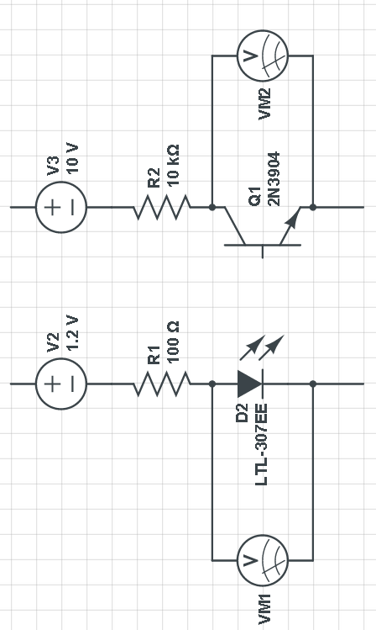
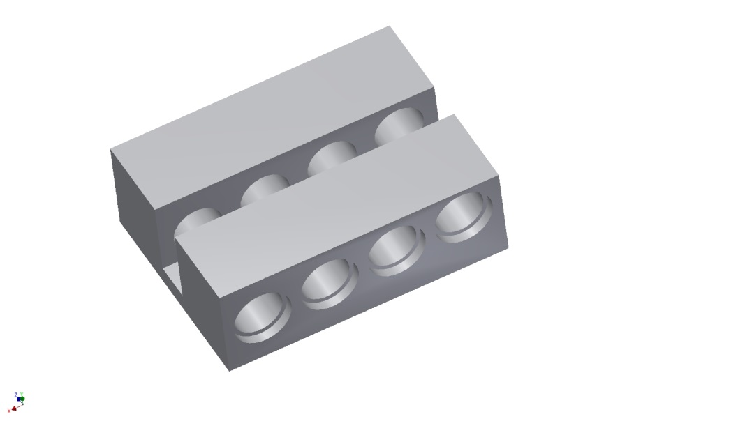
First concept of the sensor layout
We expect to cover 0.5 mm range with one LED, to fullfill requirement our sensor will be equiped with 4
wire
Electronic circuit for 1 set of components

Slide 10
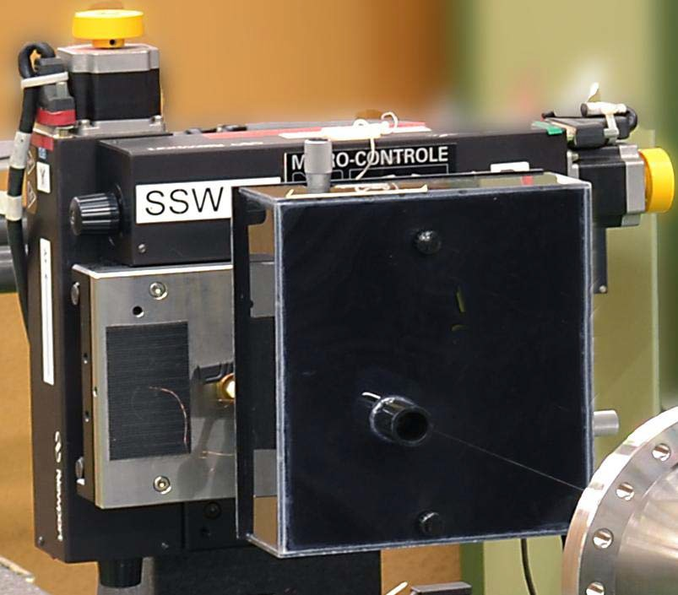
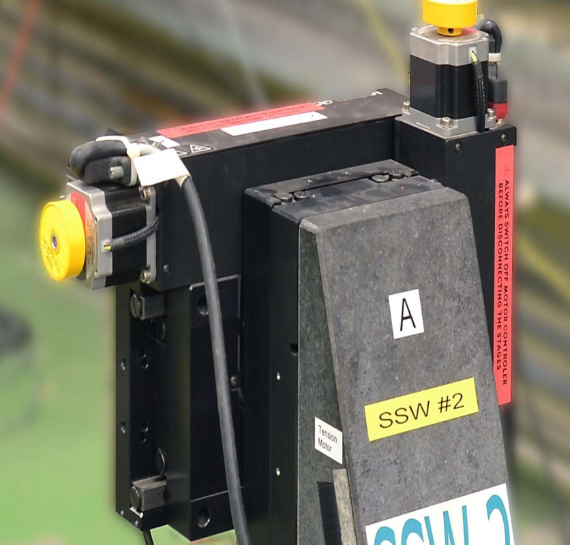
Sensor characterization at room temp
The high-precision, linear stages from Newport®, mounted in XY configuration, providing an accuracy of 1 µm on 150 mm maximum displacement. A motor controller, Newport® ESP7000, is used for acquiring the position through a linear encoder. A DC motor with a low-friction ball screw eliminates slip-stick effects and delivers displacements with 100-nm incremental motion capability. Manual adjustments can be made using a knob at the end of the motor.
An important source of the uncertainty is the parallelism of the stages. Using a Leica laser system, based on the optical interferometry effect, and level meters were used to adjust the parallelism.
Courtesy of C. Petrone

Slide 11
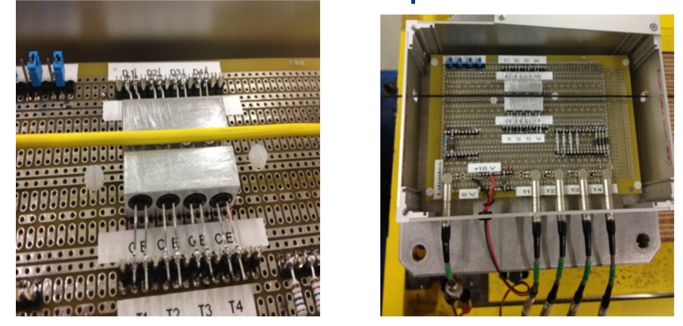
Tests setups
Test setup with 1.5 mm wire
Box to shield the environment light noise,
setup with 2.5mm wire
Courtesy of C. Petrone

Slide 12
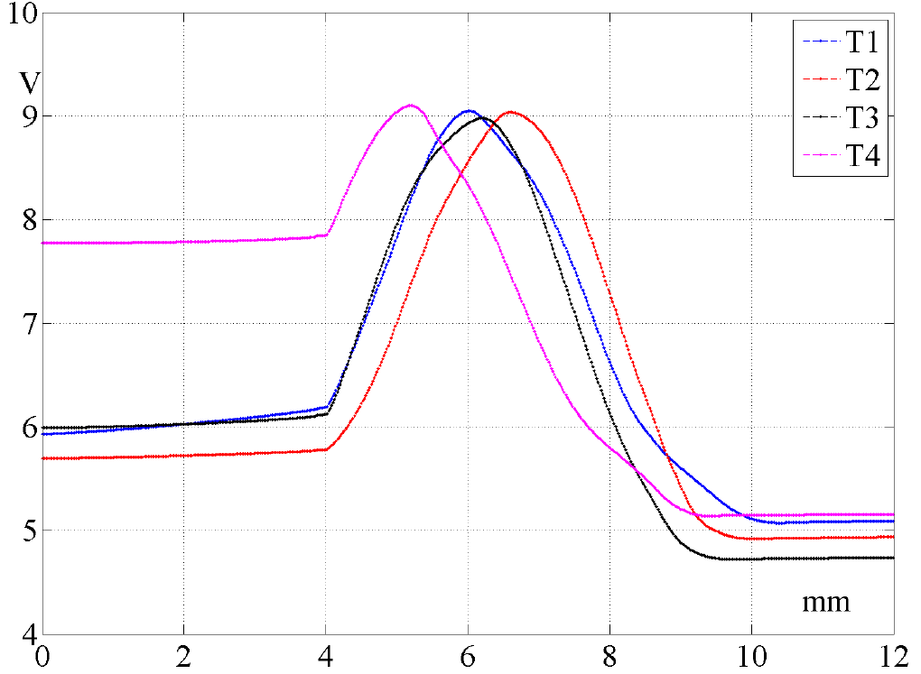
Results
Phototransistor 1
Phototransistor 2
Phototransistor 3
Phototransistor 4
2mm!
Output voltage signal variations according to the movement of the 2.5mm wire
Courtesy of C. Petrone

Slide 13
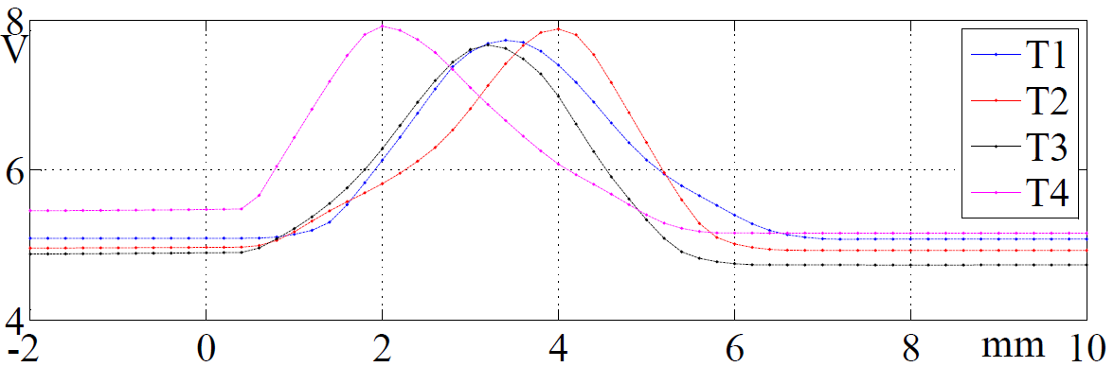
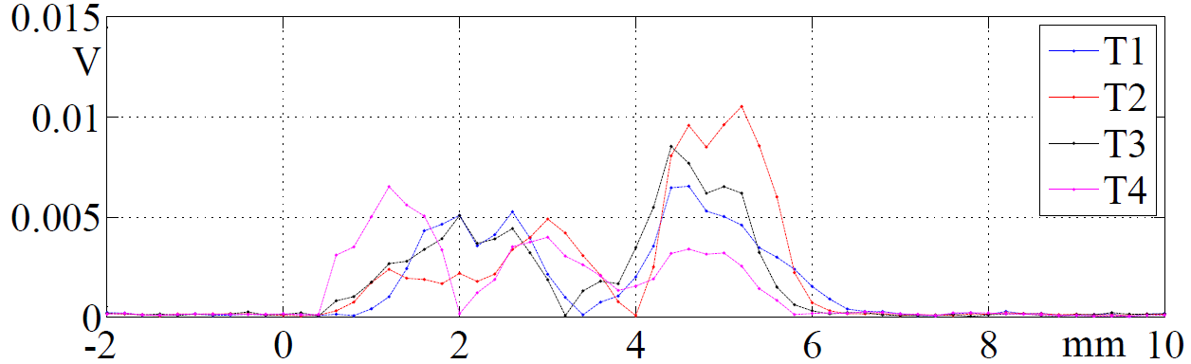
Phototransistor 1
Phototransistor 2
Phototransistor 3
Phototransistor 4
Output voltage signal variations according to the movement of the 1.5mm wire
Standard deviation on three measurements in a row
Courtesy of C. Petrone

Slide 14
Expectations for tests in liquid nitrogen
Try to reproduce plots
Reduce the size of the sensor
Check where to place the resistors: outside or inside the cryostat
Find the best way to power up LEDs and phototransistors
Design PCB which allow us easily change components
Check behavior of the components with temperature

Slide 15
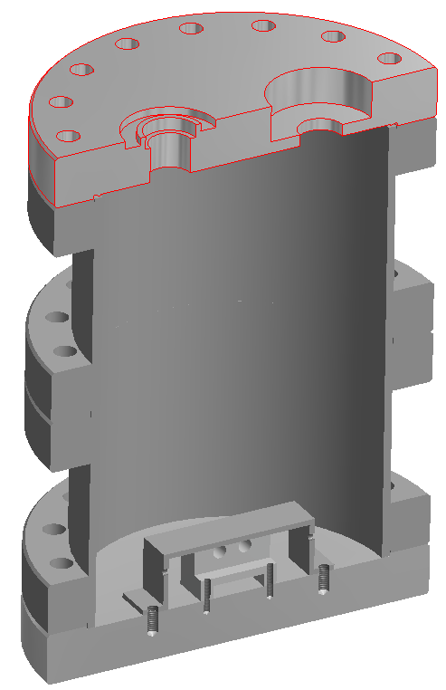
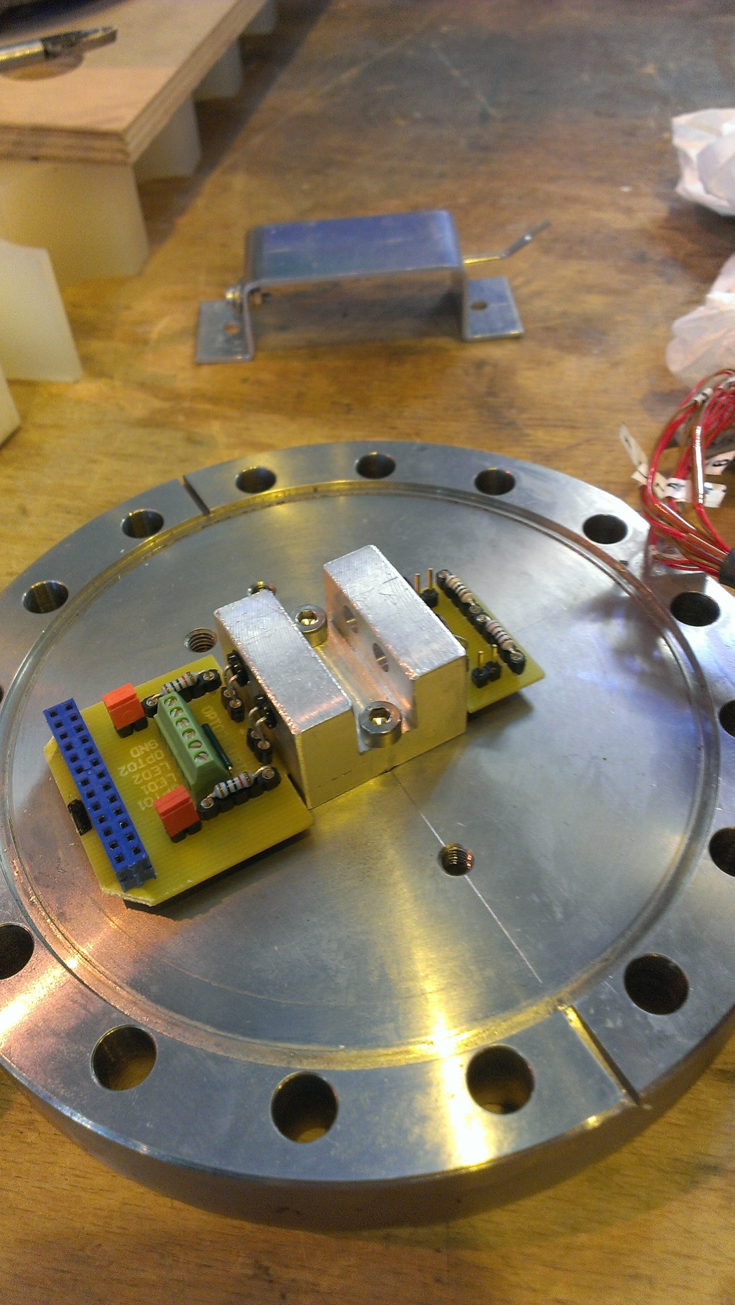
Cross section of the cryostat
Setup for tests „at cold”
PCB with two sensors
Courtesy of K. Motala
JUMPER to control which resistors to use
wire
LED/phototransistorr

Slide 16
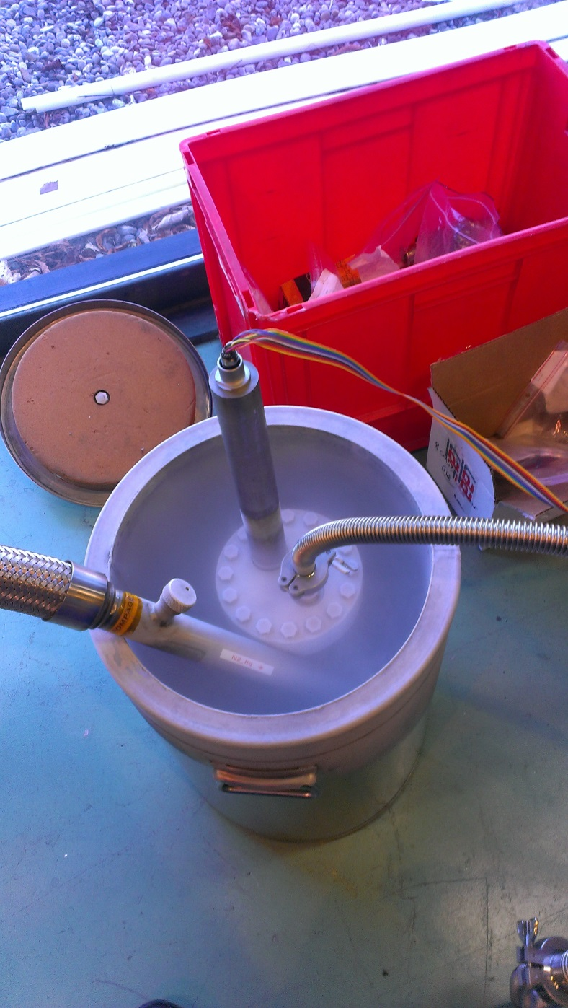
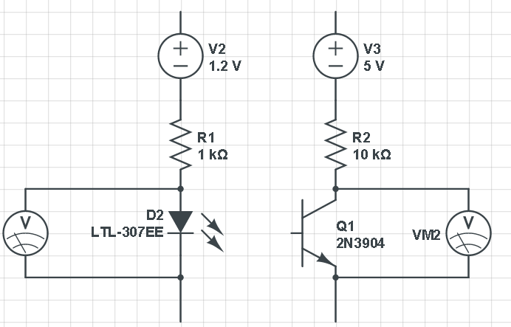
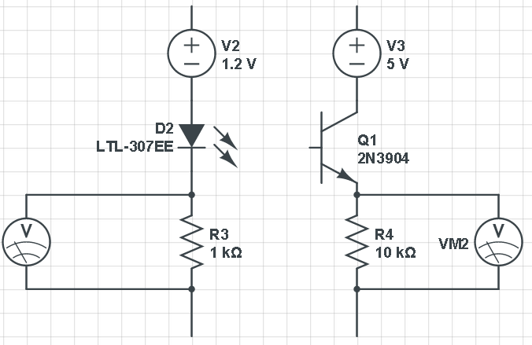
Resistors inside the cryostat
77K
Resistors outside the cryostat
77K
300K
Courtesy of K. Motala
During the test

Slide 17
Repetition test, sensor 1 – resistors inside cryostat
Samples were taken every 10 s

Slide 18
Resistors outside cryostat
Samples were taken every 10 s

Slide 19
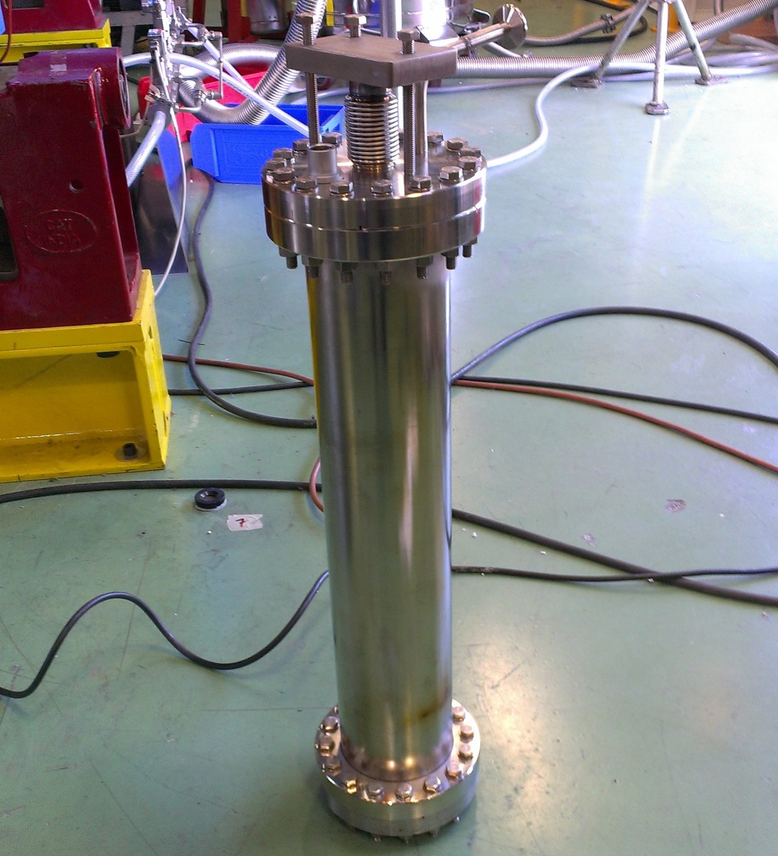
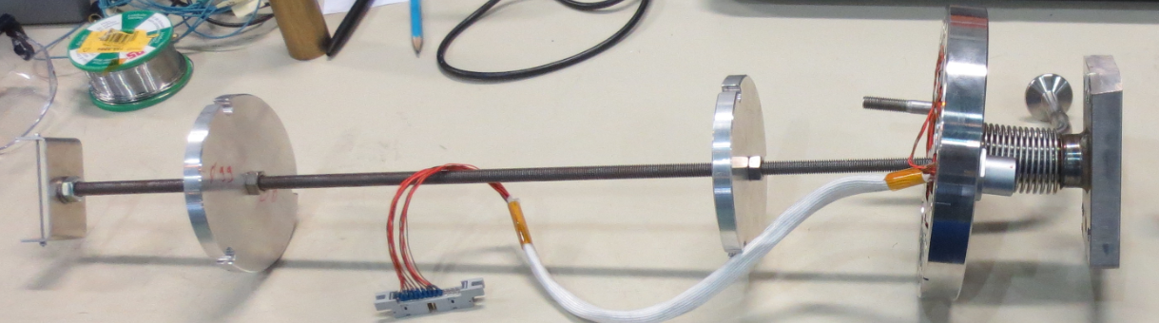
Test at cold with movable wire
New cryostat with movable wire

Slide 20
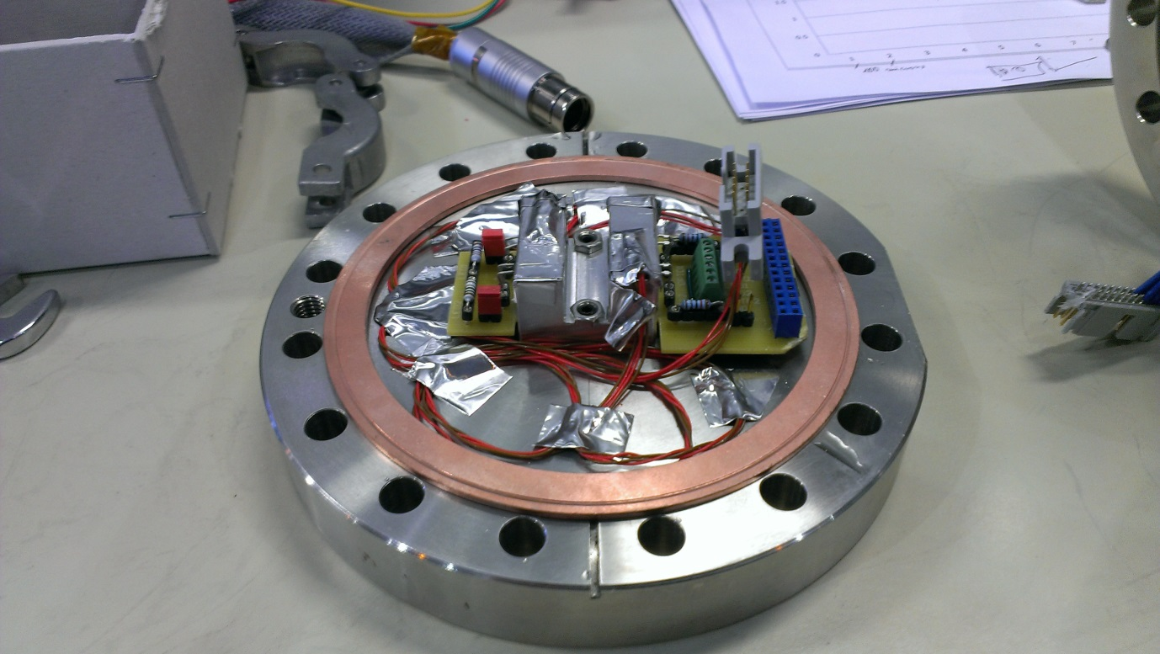
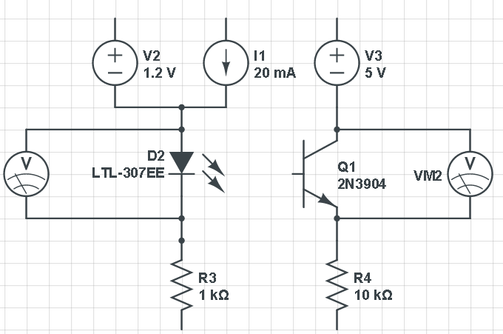
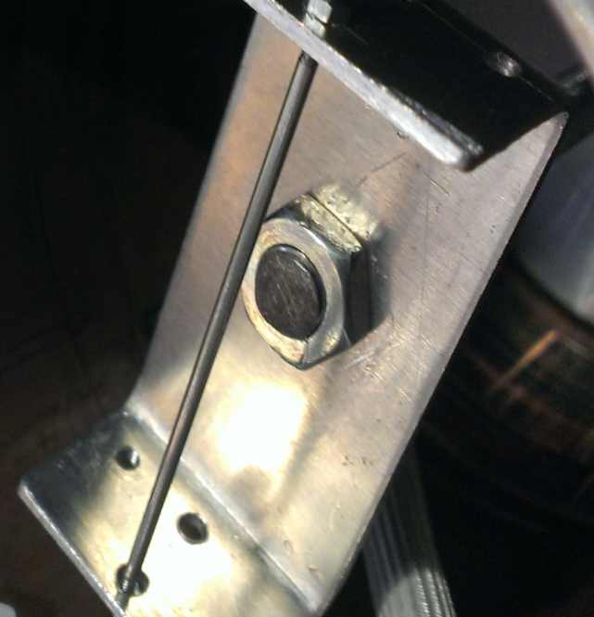
Electric circuit:
Adjustable voltage or current supply for the LEDs
Osram LED SFH 484-2
Osram phototransistor SFH313FA
3x PT100: 2 at the bottom, 1 at the top flange
Every sample correspond to 100 microns displacement of the top plate

Slide 21
First test at cold with movable wire

Slide 22
Lists of improvements:
New length of the cryostat (0.5m) to have bigger temperature drop
Fisher plugs
PCB to easily change LED and/or phototransistors
Fixation for the wire
Upgraded thermalisation for the cables
Added:
Clamps for test cryostat to the „tank” for liquid N2
Support to better guide bar with the wire
2 more linear potentiometers

Slide 23
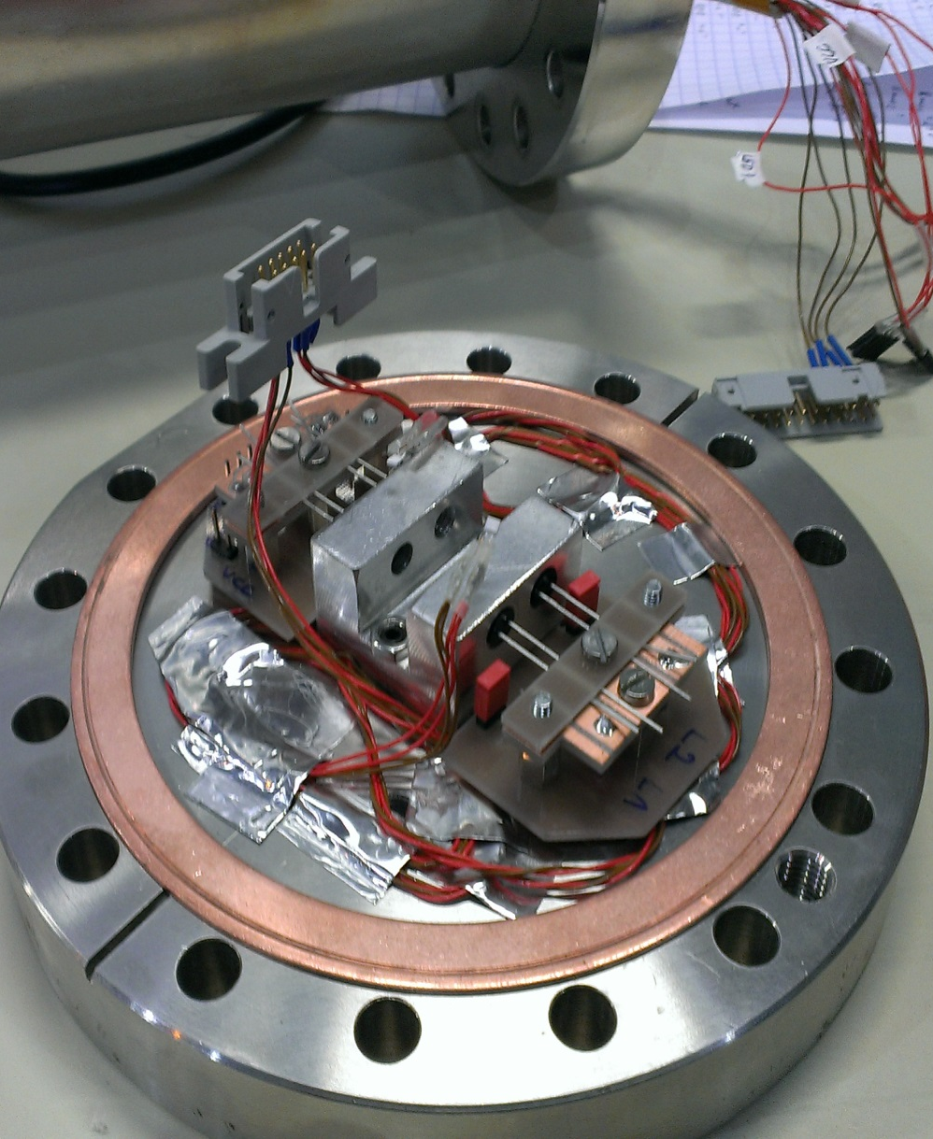
The new PCB to test different LEDs/phototransistors

Slide 24
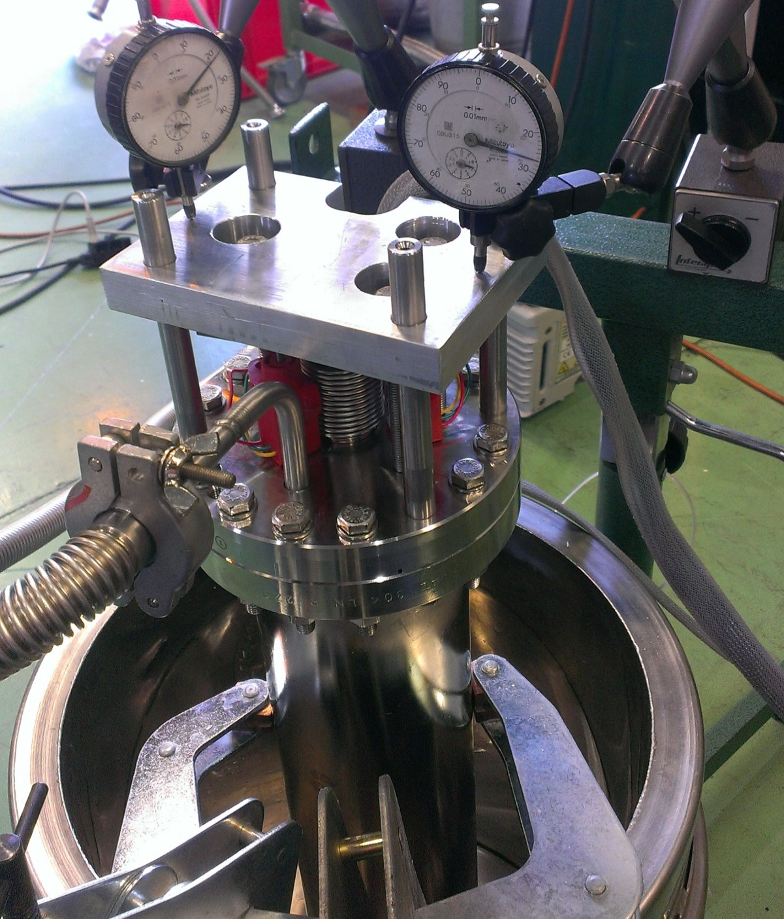
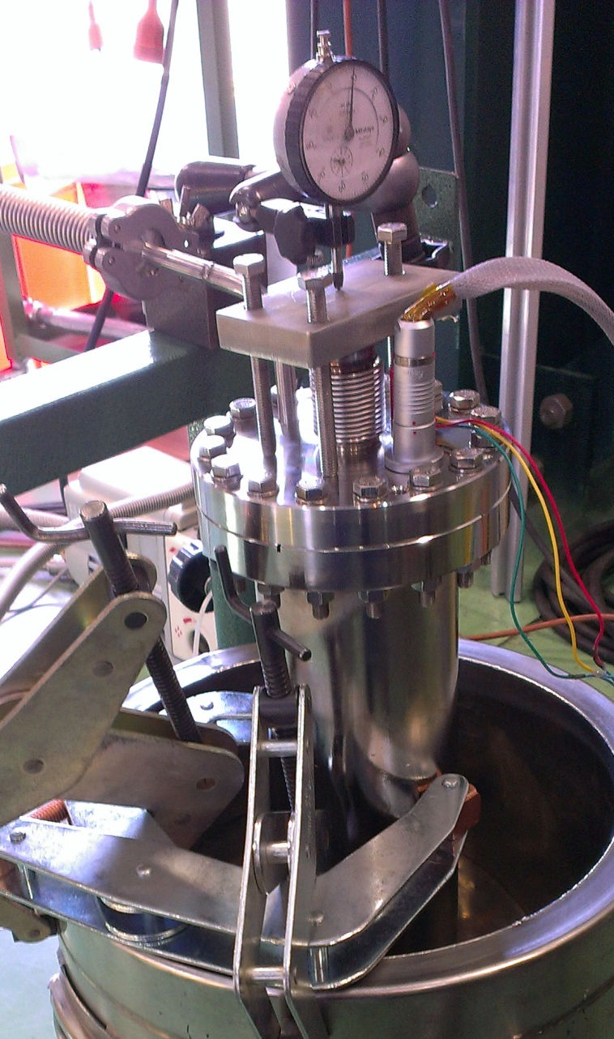
New guidance for the bar with the wire and potentiometers

Slide 25
Behavior of phototransistor with LED powered up with constant current
w stands for „warm” (300K)
c stands for „cold” (77K)

Slide 26
Behavior of phototransistor with LED powered up with constant voltage drop
w stands for „warm” (300K)
c stands for „cold” (77K)

Slide 27
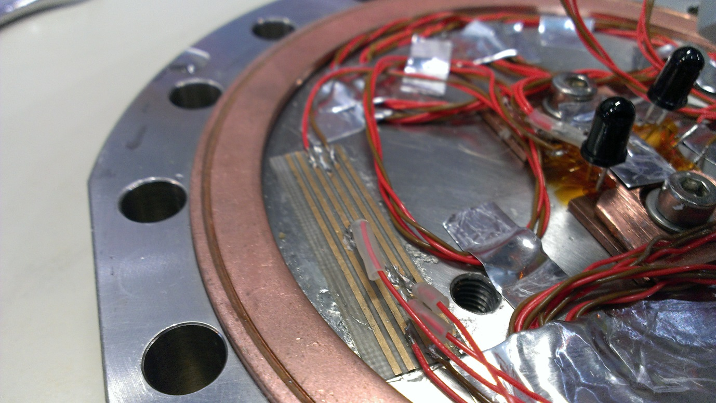
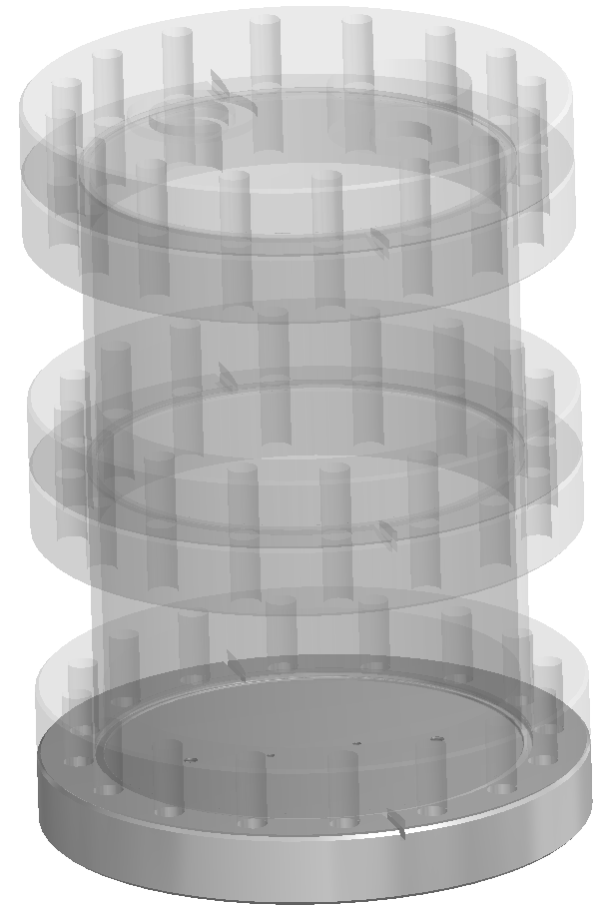
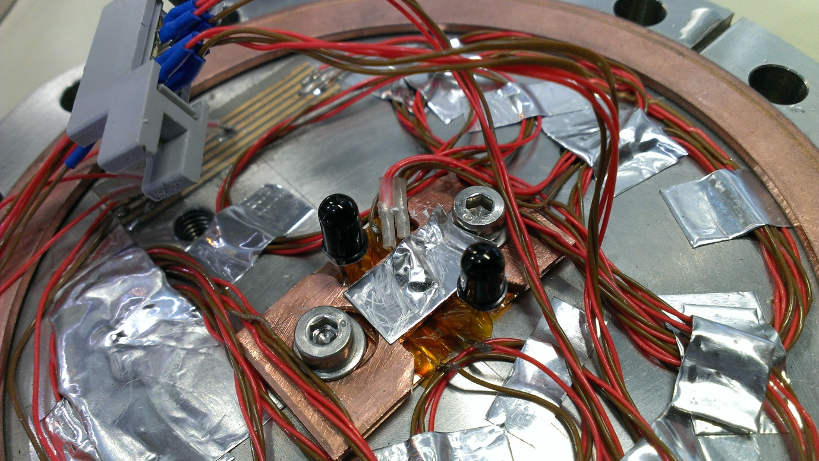
Behavior of components with temperature
PT100
300K
LED
PT100
77K
RECEIVER

Slide 28
Temperature during tests
Voltage drop at the LED
300K
LED
Voltage drop at the phototransistor 2
77K
RECEIVER

Slide 29
Zoom at the “77” K, phototransistor
Phototransistor 1 in time

Slide 30
Background measurements

Slide 31
Phototransistor 1: background measurement with the LED on (t=3h)
Test condition:
290-294K
More than 12h after test in liquid N2

Slide 32
Phototransistor 2: background measurement with the LED on (t=3h)
Test condition:
290-294K
More than 12h after test in liquid N2

Slide 33
Conclusions:
The biggest problem is lack of linear reaction to the temperature and complete different behavior of components with temperature: LED is giving more light when phototransistor is becoming less sensitive. This makes it almost impossible to apply for the transient conditions.
During the tests we’ve notice different behavior of components strongly dependent on temperature: the same test condition and different results (starting and ending point).
Final sensor will have to be equipped with a temperature sensor (for example PT100).
We can easily assume that one measurement point (in X and Y axes) will require around 10 cables: power/ground for phototransistors (3-4 cables), power/ground to the LEDs (3-4), temperature sensor (4 cables) and possibly 3 more cables for feedback system (led + phototransistor). Just for the mock-up we have 8 targets for the laser tracker: if we replace them with our solution it will make almost 80 cables for just one cavity.

Slide 34
Thank you for your attention!
&
Big „thank you”: to A. Vande Craen, K. Motala, M. Zapolski, M. Krupa, M. Strychalski, R. Bonnomi,
M. Souchet, X. Sauvage, A. Guimet, A. Bastard, C. Petrone, J. G. Perez,

